Slide 1
Pharmacotherapy: Liraglutide for Chronic Weight Management
3rd Annual Obesity Update
September 7, 2019
Sarah Cawsey MD, FRCPC

Slide 2
Disclosures
Faculty
Assistant Clinical Professor, Department of Medicine, Division of Endocrinology and Metabolism
Endocrinologist, Edmonton Adult Bariatric Clinic
Diplomate of the American Board of Obesity Medicine
Relationships with commercial interests:
Speakers Bureau/ Honoraria: Novo Nordisk, Bausch health

Slide 3
Objectives
Role of GLP-1 in appetite regulation
Clinical trials of Liraglutide (Saxenda®) in weight management
Clinical use of Liraglutide (Saxenda®) in weight management
Indications
Contraindications
Cautions
Dosing
Side Effects
Follow up
Cardiovascular outcomes

Slide 4
Multiple hormones play a key role in hunger and satiety
Stomach
Hypothalamus
BBB
Ghrelin
Hunger
Intestines
Hypothalamus
Pancreas
BBB
Amylin
Insulin
PYY
GLP-1
CCK
Satiety
Hypothalamus
Leptin
Adiponectin
BBB
Satiety
BBB, blood-brain barrier; CCK, cholecystokinin; GLP-1, glucagon-like peptide-1; PYY, peptide YY .
Suzuki K et al. Exp Diabetes Res. 2012;2012:824305.
Notes:
Gut hormones play a pivotal role in appetite regulation. Ghrelin is secreted in the stomach and acts to increase feelings of hunger and food intake. In contrast, glucagon-like peptide-1 (GLP-1), peptide YY (PYY), cholecystokinin (CCK), amylin, and insulin act to increase feelings of satiety and reduce food intake. GLP-1, PYY, and CCK are secreted from the intestines, whereas amylin and insulin are secreted from the pancreas.
Reference
Suzuki K, Jayasena CN, Bloom SR. Obesity and appetite control. Exp Diabetes Res. 2012;2012:824305.

Slide 5
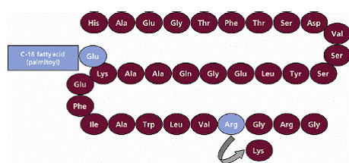
Liraglutide
Notes:
expression of recombinant DNA in Saccharomyces cerevisiae, has been engineered to be 97% homologous to native human GLP-1 by substituting arginine for lysine at position 34. Liraglutide is made by attaching a C-16 fatty acid (palmitic acid) with a glutamic acid spacer on the remaining lysine residue at position 26 of the peptide precursor. The molecular formula of liraglutide is C₁₇₂H₂₆₅N₄₃O₅₁ and the molecular weight is 3751.2

Slide 6
GLP-1 is a physiological regulator of appetite and food intake^{1*}
Like natural GLP-1, Saxenda® activates specific areas in the brain involved in the regulation of appetite and food intake*†
Saxenda® reduced
hunger, increased
fullness and satiety, and decreased food intake, compared to placebo.†
*Clinical significance has not been established.
†Data from a 5-week pharmacodynamic trial of 49 obese (BMI 30–40 kg/m²) non-diabetic patients. Appetite sensations were assessed
before and up to five hours after a standardized breakfast meal, and ad libitum food intake during the subsequent lunch meal.

Slide 7
Weight loss triggers homeostatic mechanisms that resist further weight change
metabolic rate slows more than is expected by changes in body composition (metabolic adaptation)¹
hormonal regulation of appetite is altered, leading to more hunger and less satiety²
¹Fothergill E et al. Obesity 2016;24:1612-9. (reported at https://www.nytimes.com/2016/05/02/health/biggest-loser-weight-loss.html)
²Sumithran P et al. N Engl J Med 2011;365:1597-1604.
Notes:
body weight regulation is a complex process
these changes persist (at least 1 year for hormones; metabolic adaption measured out to 6 years in Biggest Loser study)
Weight loss with lifestyle alone perhaps 5%
APPLES: lifestyle 2.8+/-8.1%
CON Report Card 2017: bariatric surgery for 1 in 183 eligible Canadians (1 in 303 in Alberta)
bariatric surgery: less metabolic adaptation, pathophysiologic hormonal changes reversed
medications: target neurohormonal (appetite) pathways

Slide 8
Medications for Obesity Management
Orlistat (Xenical®)
Liraglutide (Saxenda®)
Buproprion/Naltrexone ER (Contrave®)

Slide 9
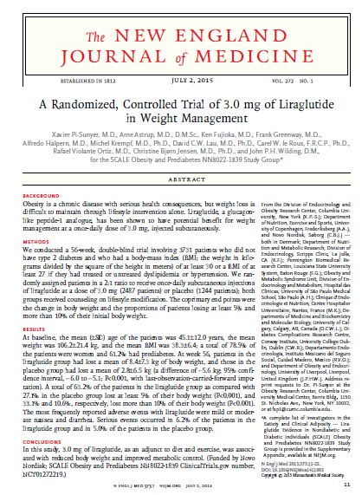
A Randomized Controlled Trial of 3.0 mg of Liraglutide in Weight Management
Pi-Sunyer X, Astrup A, Fujioka K, Greenway F, Halpern A, Krempf M, Lau DCW, le Roux CW, Violante R, Jensen CB and Wilding JPH on Behalf of the SCALE Obesity and Prediabetes NN8022-1839 Study Group
Notes:
~2500 lira group; ~1250 placebo group
~80% women, ~60% prediabetic
Mean 106 kg, BMI 38

Slide 10
Mean change in body weight (%) By prediabetes status: 0–56 weeks
Normoglycemia
Liraglutide 3.0 mg
Placebo
With prediabetes
Liraglutide 3.0 mg
Placebo
LOCF
-2.6%
-2.7%
-3.4%
-3.6%
Change in body weight (%)
-7.9%
LOCF
-8.0%
-9.2%
-9.2%
Weeks
Data are observed means with standard error bars, and the symbols at the right represent the 56-week weight change using LOCF imputation
Pi-Sunyer et al. NEJM 2015;373:11-22

Slide 11
Categorical weight loss At week 56
Liraglutide 3.0 mg
Placebo
OR 4.8 (95% CI, 4.1 to 5.6) P<0.001
OR 4.3 (95% CI, 3.5 to 5.3) P<0.001
Patients (%)
OR 4.9 (95% CI, 3.5 to 6.7) P<0.001
Weight loss
Data are observed means for the full analysis set (with LOCF) and the odds ratios (OR) and 95% confidence interval (CI) shown are from a logistic regression analysis (the analysis for achieving 15% weight loss was performed post hoc)
Pi-Sunyer et al. NEJM 2015;373:11-22
Notes:
Fig 1b
Data are observed means for the full analysis set (with LOCF) and the odds ratios (OR) and 95% confidence interval (CI) shown are from a logistic regression analysis (the analysis for achieving 15% weight loss was performed post hoc).

Slide 12
Mean change in body weight (%) 0–172 weeks
Mean baseline weight: 108 kg
Liraglutide 3.0 mg
Placebo
Off drug follow up
Off drug follow up
LOCF
LOCF
-1.9
-2.1
-2.7
-5.2
Change in weight (%)
-6.1
-7.1
Week
n=
1467
1295
1223
1161
1100
1030
971
911
885
849
830
805
780
747
778
n=
734
635
576
544
508
465
436
399
375
365
354
336
327
322
320
le Roux et al. Obesity Week 2015, 2–6 November 2015, Poster T-P-LB-3843
Notes:
FAS, fasting visit data only. Line graphs are observed means (±SE). Circles are observed means LOCF. Statistical analysis is ANCOVA. Subjects did not receive treatment during observational follow-up, between weeks 160–172. FAS, full analysis set; LOCF, last observation carried forward; SE, standard error
Source: NN8022-1839-MAIN-EXT. Data on file. Novo Nordisk A/S: Figure 14.2.41; Table 14.2.33
Table, 14.1.11
The population for the 1839 3-year clinical trial report consists of all subjects with prediabetes, except the 37 subjects that went into the re-randomised period, and 6 subjects with normoglycaemia who entered the extension.

Slide 13
Saxenda® (liraglutide) indication
Saxenda® (liraglutide) is indicated as an adjunct to a reduced calorie diet and increased physical activity for chronic weight management in adult patients with an initial body mass index (BMI) of:
≥30 kg/m² or greater (obese), or
≥27 kg/m² or greater (overweight) in the presence of at least one weight-related comorbidity (e.g., hypertension, type 2 diabetes, or dyslipidemia) and who have failed a previous weight management intervention
Saxenda® (liraglutide), Product Monograph, Novo Nordisk Canada Inc, June 2015

Slide 14
Saxenda® (liraglutide) contraindications
Personal or family history of medullary thyroid carcinoma or in patients with Multiple Endocrine Neoplasia syndrome type 2 (MEN 2)
Hypersensitivity to liraglutide or to any ingredient in the formulation
Pregnant and breastfeeding women
Saxenda® (liraglutide), Product Monograph, Novo Nordisk Canada Inc, June 2015

Slide 15
Saxenda® (liraglutide) cautions
Severe renal impairment (GFR < 30)
Hepatic insufficiency
Prior pancreatitis
Unstable cardiovascular disease
Saxenda® (liraglutide), Product Monograph, Novo Nordisk Canada Inc, June 2015
Notes:
Victoza labelling for GFR to 15
Ok in NAFLD
Pancreatitis rates not higher in LEADER (numerically fewer in lira 1.8 group)
LEADER enrollment: The major inclusion criteria were the following: an age of 50 years or more with at least one cardiovascular coexisting condition (coronary heart disease, cerebrovascular disease, peripheral vascular disease, chronic kidney disease of stage 3 or greater, or chronic heart failure of New York Heart Association class II or III) or an age of 60 years or more with at least one cardiovascular risk factor, as determined by the investigator (microalbuminuria or proteinuria, hypertension and left ventricular hypertrophy, left ventricular systolic or diastolic dysfunction, or an ankle–brachial index [the ratio of the systolic blood pressure at the ankle to the systolic blood pressure in the arm] of less than 0.9)

Slide 16
Considerations in Patients with Diabetes
Stop DPP-4 inhibitors and other GLP-1 agonists
Reduce or discontinue insulin secretagogues
Recommendation against co-administration with insulin¹

Slide 17
Saxenda® (liraglutide) side effects
Gastrointestinal symptoms
Nausea, constipation, diarrhea, dyspepsia
Dizziness
Dysgeusia

Slide 18
Proportion of subjects with nausea 0–56 weeks
Liraglutide 3.0 mg
Placebo
Proportion of patients reporting nausea at:
Week 4: 24.7% (liraglutide) vs. 5.4% (placebo)
Week 8: 14.7% (liraglutide) vs. 3.2% (placebo)
Week 56: 5.5% (liraglutide) vs. 1.7% (placebo)
Proportion of subjects (%)
Week
Safety analysis set
Pi-Sunyer et al. NEJM 2015;373:11-22
Notes:
Fig S7
Observed mean data for the safety analysis set (liraglutide N=2481; placebo N=1242). 75 patients in the liraglutide group withdrew owing to nausea compared with 4 in the placebo group.
The most common AEs with liraglutide 3.0 mg were nausea, diarrhoea and constipation
Nausea onset was largely in weeks 1−4; most events were mild/moderate and transient

Slide 19
Dosage and administration
The 0.6, 1.2, 1.8, and 2.4 mg doses are intended to reduce gastrointestinal symptoms during initial dose escalation
If patients do not tolerate an increased dose during dose escalation, the dose escalation can be changed with a total delay of up to 7 days
Saxenda® (liraglutide), Product Monograph, Novo Nordisk Canada Inc, June 2015
Notes:
I direct patients to delay dose escalation by an additional week (or longer) if:
Still having GI side effects
Lost >3 pounds in previous week

Slide 20
Strategies to mitigate GI side effects
Delay dose escalation
Increase dose in smaller increments
Administer at bedtime
Submaximal dose
Change to a once weekly GLP-1 agonist¹
¹Trujillo JM et al. Ther Adv Endocrinol Metab 2015;6:19-28

Slide 21
Safety
Gallbladder disease
Cholelithiasis: 2.2% Liraglutide vs. 0.8% placebo
Cholecystitis: 0.8% Liraglutide vs. 0.4% placebo
Breast Neoplasms
Breast cancer in 0.7% of Liraglutide treated women vs. 0.2% placebo treated
Too few cases to determine if Liraglutide related
Enhanced ascertainment
Notes:
Substantial or rapid wt loss can increase the risk of gallstones; but still higher in Lira group after accounting for wt loss
Based on the low number of events, the short interval between study entry and diagnosis of breast cancer
with nodal involvement in most cases, receptor status consistent with distribution in a population of
obese women who may not have participated regularly in a breast cancer screening program, and greater
than the average weight loss in women with events (Supplemental Table S13.), it is likely that the event
imbalance observed is not causally related to liraglutide, but a chance finding or resulting from enhanced
ascertainment.
17/2379 vs. 3/1300 in placebo group
13 invasive vs. 2 in placebo

Slide 22
Followup
Heart rate, blood pressure, weight
Glycemic control in diabetics
GI side effects
Effect on appetite
meal skipping
calorie intake
protein intake (target 1 – 1.2 g / kg ideal body weight)

Slide 23
Followup
Stopping rule: Treatment with Saxenda® should be discontinued after 12 weeks on the 3.0 mg/day dose if a patient has not lost at least 5% of their initial body weight¹
Return of appetite
Weight loss plateau
¹Saxenda® (liraglutide), Product Monograph, Novo Nordisk Canada Inc, June 2015
Notes:
Proportions of ERs/ENRs to liraglutide 3.0 mg were 77.3%/22.7% (individuals without type 2 diabetes, T2D) and 62.7%/37.3% (those with T2D). Greater mean weight loss was observed in ERs versus ENRs: 10.8% versus 3.0% (without T2D) and 8.5% versus 3.1% (T2D). In both trials, greater proportions of ERs versus ENRs achieved ≥5%, >10%, and >15% weight loss at week 56 with liraglutide 3.0 mg. Greater improvements in cardiometabolic risk factors and health-related quality of life scores were observed in ERs versus ENRs. Obesity (Silver Spring). 2016 Nov; 24(11): 2278–2288.

Slide 24
SaxendaCare™
A FREE support program focused on small steps that help patients work towards their weight management goals—encourage your patients to enrol today!
Patients who enrol in SaxendaCare™ receive FREE access to a step-by-step support program designed to help them adhere to their therapy by:
Getting them off to a good start on Saxenda® by learning how to inject, titrate and manage side effects
Helping them build skills to make healthier choices and stay motivated
Benefits include:
Access to SaxendaCare™ Registered Nurses and Dietitians to provide support, answers to questions, and help with pen training
Tools and resources to help patients get started with Saxenda®
A website that includes education and tools on proper nutrition, physical activity and staying motivated
Weekly emails to guide patients along the way, keep them motivated and reinforce adherence
Encourage your Saxenda® patient to enrol by calling 1-844-SAX-ENDA (1-844-729-3632) or by visiting www.SaxendaCareCanada.ca
Notes:
SCALE
- standardized lifestyle counseling approximately monthly
- Standardized dietary and exercise counseling was provided, in individual or group sessions, up to week 68. Patients were advised to increase their physical activity to at least 150 minutes per week and to reduce their daily energy intake to 500 kcal below their individualized energy requirements based on World Health Organization estimates and an ‘average’ physical activity factor of 1.3.1 The recommended macronutrient distribution was 30% of energy from fat, 20% from protein, and 50% from carbohydrate. To encourage adherence, pedometers were provided and a 3-day food diary was dispensed for completion every second month.

Slide 25
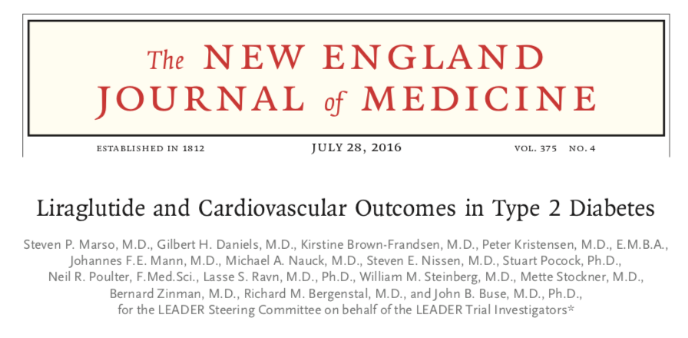
Cardiovascular outcomes with Liraglutide

Slide 26
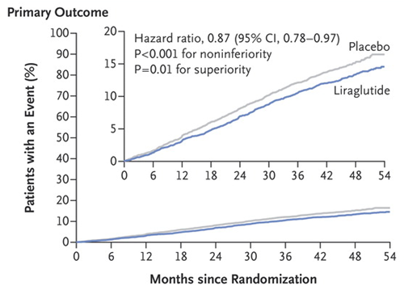

Slide 27
Questions

